Slide 1
Dealing with Imbalanced Data, Small Datasets and Ensemble Methods

Slide 2
Agenda
Dealing with Imbalanced Data, Small Datasets and Ensemble Methods:
Bagging
Boosting
SMOTE
Cross Validation

Slide 3
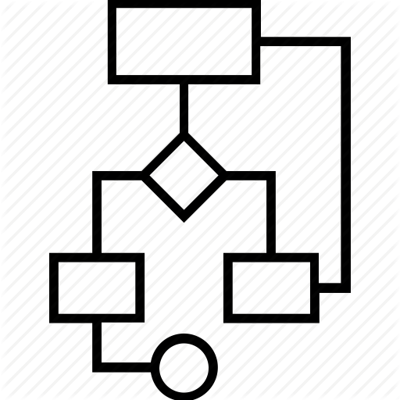
Ensemble Methods
What exactly is an ensemble method? Training multiple models using the same algorithm. Many times you will hear this is a way to create a strong learner from a weak one. Ensemble methods can be used to try and minimize, bias and variance.
vs

Slide 4
Ensemble Methods
Bagging (aka Bootstrap Aggregating): is a way to decrease the variance of your prediction by generating additional data for training from your original dataset using combinations with repetitions to produce multisets of the same cardinality/size as your original data.
Boosting: the idea of training the weak learners sequentially

Slide 5
Ensemble Methods
Bagging is in parallel
Boosting is sequential

Slide 6






Bagging
Bagging: each bootstrap has the same size as original. Accomplished by sampling with replacement.
Our true observed data
Our bootstraps

Slide 7
Bagging
Our bootstraps
Weak learner
If x>=0.05, y = 1
If x>=0.75, y = 1
If x<=0.35, y = 1
If x<=0.35, y = 1
If x>=0.65, y = 1

Slide 8





Bagging
Our bootstraps
Weak learner
learner data
If x>=0.05, y = 1
If x>=0.75, y = 1
If x<=0.35, y = 1
If x<=0.35, y = 1
If x>=0.65, y = 1

Slide 9


Bagging
learner data
Classification based on majority
True classification
sums

Slide 10
Boosting Methods
AdaBoost (Adaptive Boosting) – building on weak learners combining decision stumps and weighting incorrect observations.
Gradient Boosting – builds on each model, trying to fit the next model to the residuals of the previous model
XGBoost (Extreme Gradient Boosting) – a specialized implementation of gradient bosting decision trees designed for performance. Three main types are: gradient boosting, stochastic gradient boosting and regularized gradient boosting

Slide 11
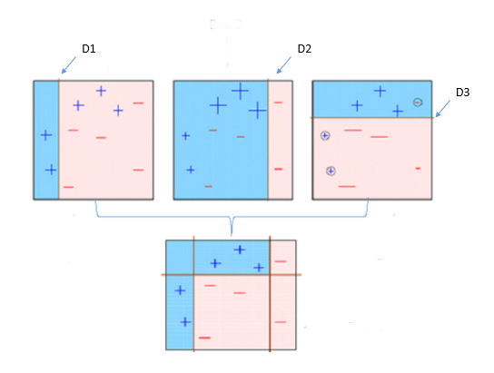
Boosting Methods
AdaBoost (Adaptive Boosting) – Building on weak learners combining decision stumps and weighting incorrect observations.

Slide 12
Boosting Methods
Gradient Boosting – builds on each model, trying to fit the next model to the residuals of the previous model

Slide 13
bias-variance tradeoff
bias-variance tradeoff
The bias is an error from erroneous assumptions in the learning algorithm. High bias can cause an algorithm to miss the relevant relations between features and target outputs (underfitting).
The variance is an error from sensitivity to small fluctuations in the training set. High variance can cause an algorithm to model the random noise in the training data, rather than the intended outputs (overfitting).
Boosting helps reduce both bias and variance
Bagging reduces the variance, but retains some of the bias

Slide 14
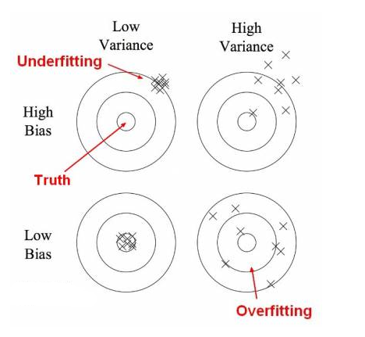
bias-variance tradeoff

